Slide 1
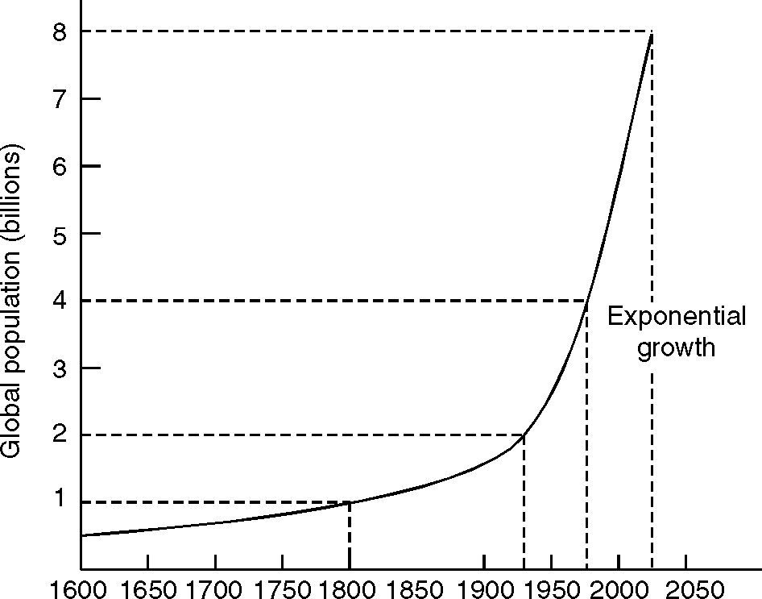
Human Population and the Environment
Population growth:

Slide 2
POPULATION CHARACTERISTICS AND VARIATIONS
AMONG NATIONS
Demography means study of human populations.
India stands in second position after China in population. As of 2018 India’s yearly change percentage of population is 1.11%. China’s population to world share is 18.54%, whereas India’s world share is 17.74%.
With scientific and technological advancement, life expectancy of humans improved. People started living in definite settlements lead ing a more stable life with better sanitation, food and medical facili ties.
There are cultural, economic, political and demographic reasons that explain the differences in the rate of population control in different countries.

Slide 3
Population explosion – Family Welfare Programme
Human population growth increased from:
1 to 2 billion, in 123 years.
2 to 3 billion, in 33 years.
3 to 4 billion, in 14 years.
4 to 5 billion, in 13 years.
5 to 6 billion, in 11 years.
In response to our phenomenal population growth, India seriously took up an effective Family Planning Program

Slide 4
Population explosion – Family Welfare Programme
Informing the public about the various contraceptive measures that are available is of primary importance. This must be done actively by Government Agencies such as Health and Family Welfare, as well as Education and Exten sion workers.

Slide 5
ENVIRONMENT AND HUMAN HEALTH
We expect urbanization and industrialization to bring in prosperity, but on the down side, it leads to diseases related to overcrowding and an inadequate quality of drinking water, resulting in an increase in waterborne diseases such as infective diarrhoea and air borne bacterial diseases such as tuberculosis.
High-density city traffic leads to an increase in respiratory diseases like asthma. Agricultural pesticides that enhanced food supplies during the green revolution have affected both the farm worker and all of us who consume the produce.

Slide 6
ENVIRONMENT AND HUMAN HEALTH
Modern medicine promised to solve many health problems, especially associated with infectious diseases through antibiotics, but bacteria found ways to develop esistant strains, frequently even changing their behaviour in the process, making it necessary to keep on creating newer antibiotics. Many drugs have been found to have serious side effects. At times the cure is as damaging as the disease process itself.

Slide 7
ENVIRONMENT AND HUMAN HEALTH
Environmental health
Climate and health
Infectious diseases (Tuberculosis (TB), Malaria)
Water-related diseases (cholera, typhoid, Diarrhoea, dysentery, polio, meningitis, and hepatitis A and E)
Water related vector diseases (Malaria, dengue fever)
Water scarcity diseases: tuberculosis, leprosy, tetanus, etc. which occur when hands are not adequately washed.
Arsenic in drinking water The main source of arsenic in drinking water is arsenic-rich rocks through which the water has filtered. It may also occur because of mining or industrial activity in some areas.

Slide 8
ENVIRONMENT AND HUMAN HEALTH
Water with high concentrations of arsenic if used over 5 to 20 years, results in problems such as colour changes on the skin, hard patches on the palms and soles, skin cancer, cancers of the bladder, kidney and lung, and diseases of the blood vessels of the legs and feet. It may also lead to diabetes, high blood pressure and reproductive disorders.

Slide 9
ENVIRONMENT AND HUMAN HEALTH
Environmental health, as defined by WHO, comprises those aspects of human health, including quality of life, that are determined by physical, chemical, biological, social, and psychosocial factors in the environment. It also refers to the theory and practice of assessing, correcting, controlling, and preventing those factors in the environment that adversely affect the health of present and future generations. Thus environmental health and human health are closely interlinked.An improvement in health is central to sound environmental management.

Slide 10
Climate and health
Both climate and weather have a powerful impact on human life and health issues.
Malaria transmission is particularly sensitive to weather and climate. Unusual weather conditions, for example a heavy downpour, can greatly increase the mosquito population and trigger an epidemic.
Other diseases were not known to science earlier and seem to have suddenly hit our health and our lives during the last few decades. AIDS, due to the Human Immunodeficiency Virus (HIV) caused through sexual transmission and Severe Acute Respiratory Syndrome (SARS) are two such examples.

Slide 11
Cancer and environment
Cancer is caused by the uncontrolled growth and spread of abnormal cells that may affect almost any tissue of the body. Lung, colon, rectal and stomach cancer are among the five most common cancers in the world for both men and women.
More than 10 million people are diagnosed with cancer in the world every year. It is estimated that there will be 15 million new cases every year by 2020. Cancer causes 6 million deaths every year – or 12% of deaths worldwide.

Slide 12
Cancer and environment
Cancer is preventable by stopping smoking, providing healthy food and avoiding exposure to cancer-causing agents (carcinogens).

Slide 13
HUMAN RIGHTS
Equity
The right to the use of natural resources that the environment holds is an essential component of human rights.
Nutrition, health and human rights
There are links between environment, nutrition and health which must be seen from a humanrights perspective. Proper nutrition and health are fundamental human rights. The right to life is a Fundamental Right in our constitution.

Slide 14
HUMAN RIGHTS
Intellectual Property Rights and Community Biodiversity Registers
Traditional people, especially tribals living in forests, have used local plants and animals for generations. This storehouse of knowledge leads to many new ‘discoveries’ for modern pharmaceutical products. The revenue generated from such ‘finds’ goes to the pharmaceutical industry that has done the research and patented the product. This leaves the original tribal user with nothing while the industry could earn billions of rupees. To protect the rights of indigenous people who have used these products, a possible tool is to create a Community Biodiversity Register of local products and their uses so that its exploitation by the pharmaceutical industry would have to pay a royalty to the local community.
In industrialized countries, adaptations of traditional medicine are termed “Complementary“ or “Alternative” Medicine (CAM).

Slide 15
VALUE EDUCATION
Value education in the context of our environment is expected to bring about a new sustainable way of life. Education both through formal and non-formal processes must thus address understanding environmental values, valuing nature and cultures, social justice, human heritage, equitable use of resources, managing common property resources and appreciating the cause of ecological degradation.

Slide 16
WOMAN AND CHILD WELFARE
There are several environmental factors that are closely linked to the welfare of women and children. Each year, close to eleven million children worldwide are estimated to have died from the effects of disease and inadequate nutrition. Most of these deaths are in the developing world. In some countries, more than one in five children die before they are 5 years old. Seven out of 10 of childhood deaths in developing countries can be attributed to five main causes, or a combination of them. These are pneumonia, diarrhoea, measles, malaria and malnutrition.

Slide 17
ROLE OF INFORMATION TECHNOLOGY
IN ENVIRONMENT AND HUMAN HEALTH
The relationship between the environment and health has been established due to the growing utilisation of computer technology. This looks at infection rates, morbidity or mortality and the etiology (causative factors) of a disease. As knowledge expands, computers will become increasingly efficient. They will be faster, have greater memories and even perhaps begin to think for themselves.

